Slide 2
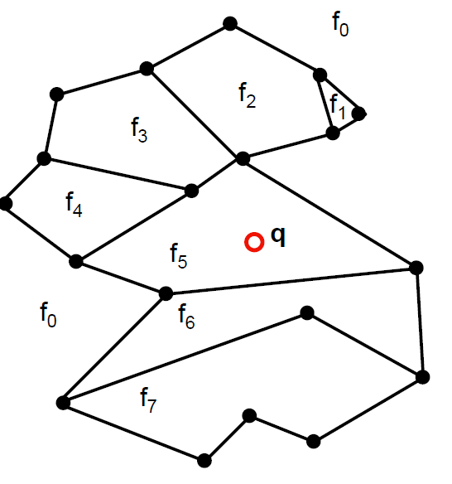
Introduction
Point location query: Given a map of n
edges and a query point q speciﬁed by
its coordinates, ﬁnd the region of the
map that containing point q.
Regions are the planar sub-division
of the map, which are denoted as f0,f1
etc. in given figure.

Slide 3
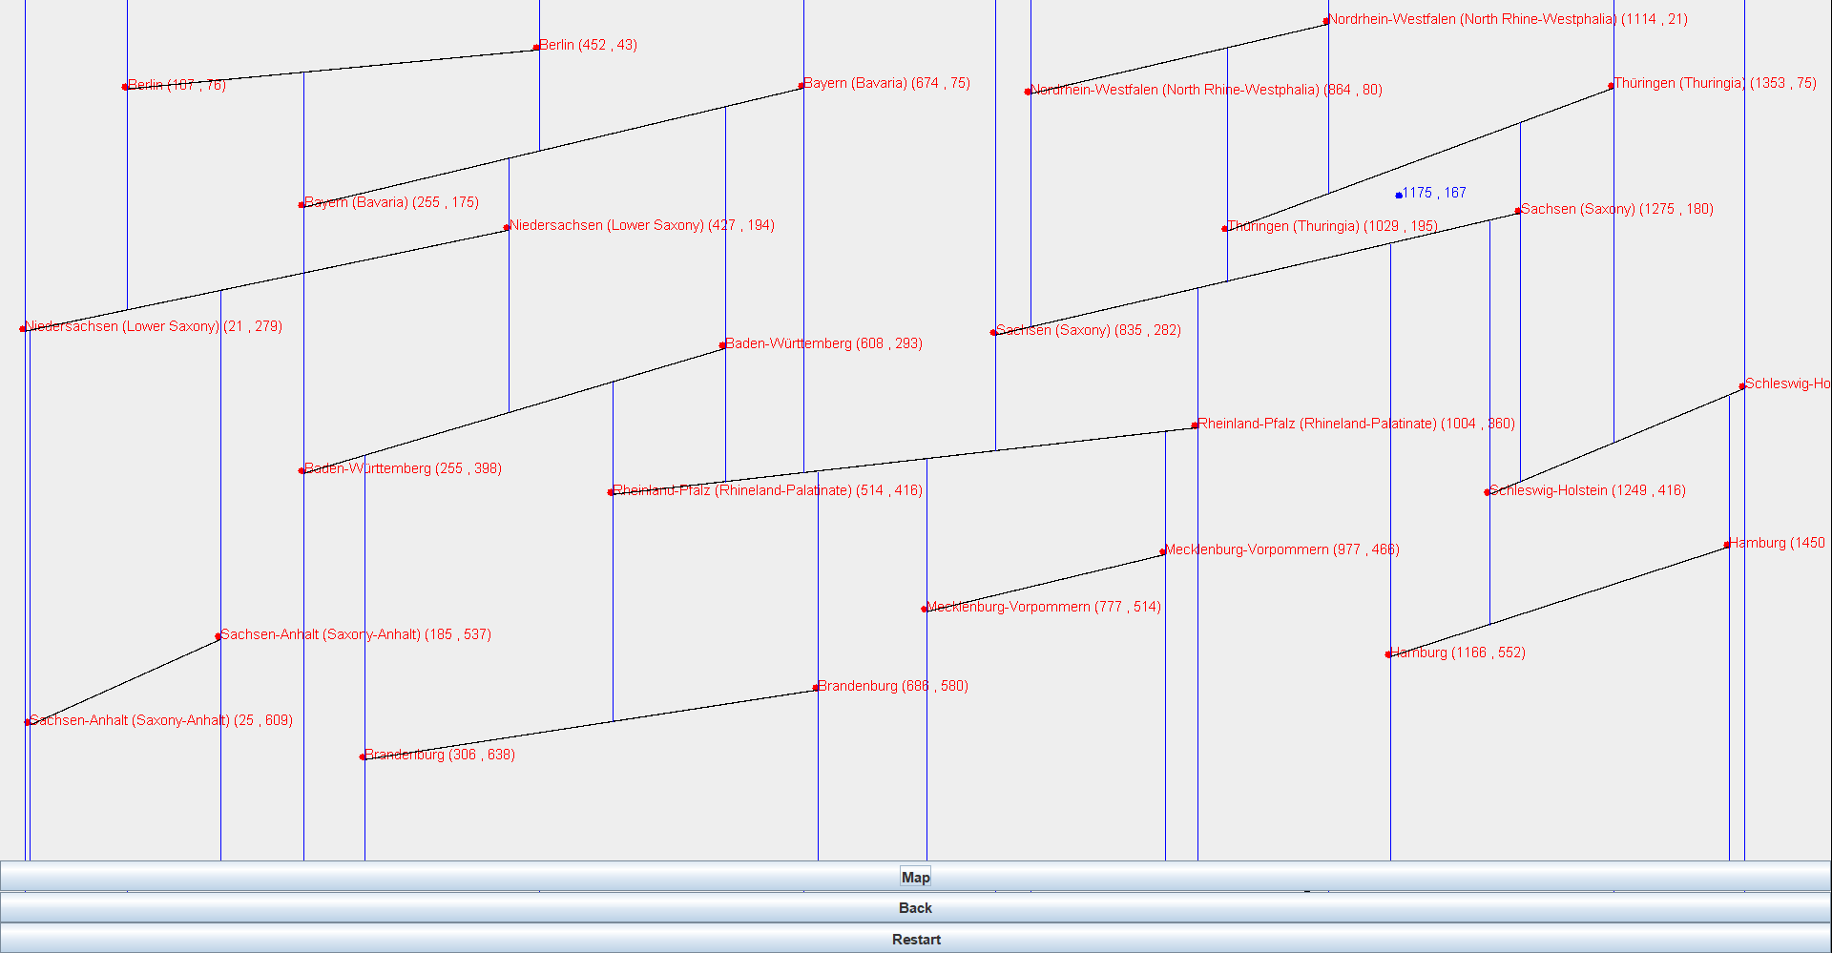
Task solved in java GUI
Trapezoidal mapping using a randomized incremental algorithm in Java GUI, where set of line segments represent as a 16-states of Germany.

Slide 4
Implementation
Input data is given through a Jswing GUI e.g. points, line segments and retrieving point.
Jframe of size 600*600 is taken as a bounding box.
In an Jframe content pane, Left mouse click is used to draw successive points of a line segment in a panel.
Graphics package of Jswing is used to draw line segments, points , and to extend vertical lines, which form trapezoids.
Jbutton “Map” is used to sub-divide the bounding box into trapezoids according to drawn line segments and also to localize the query point.
Jbutton “Restart” is used to erase all existing segments from GUI.
Jbutton “Back” is used to erase the last segment entry from GUI.

Slide 5
Implementation and List of classes used.
Point: To create points of segments with x and y co-ordinates.
Node: It is part of acyclic graph data structure used in a problem, which are used to store data as a type of line segments, points and trapezoids.
Graph: A data structure used to save the nodes in post-order, pre-order and in-order traverse for data retrieval. It is also used to represent the tree structure of retrieving point.
Shape: it is used to identify the points relation to a particular segment and check the intersections of the segments. It is a final list of segments for further algorithm execution.

Slide 6
Implementation
Trapezoidal line: It is used to check and draw vertical extension of lines from segment end points until the closer top or bottom segments are observed.
Trapezoidal panel: It is implemented to store the formed trapezoidal panels after the trapezoidal formation from a vertical line extensions. It stores all the points, lines and faces after the map button is clicked.
Trapezoidal face : It is a datastructure implemented to provide an identification of the faces and its relation with respect to the objects of its neighbours.eg segment top face , segment bottom face, left point, right point, which lies in the faces like upper left face or upper right and lower left face or lower right face.

Slide 7
Implementation
Trapezoidal Map: it consists of “naive” approach Creates trapezoidal maps the "naive" way. More specifically, this function iterates through each shape, and each point of each shape,
creating a Trapezoid Line for each point with an initially long length. Then, this length is minimized over all the x intersections for above the point. This is repeated for all the lines below the point.
TrapezoidalMapDriver: It is a driver class, which mainly consists GUI implementation like buttons, frame, panels etc. and a main class to execute all the methods for Trapezoidal panel formations, and store and retrieve data from tree structure.

Slide 8
Time Complexity
Given a planar subdivision defined by a set shapes of n non-crossing line segments in the plane
Creating the search structure Graph for planar point location queries in O(nlog n) expected time
The search structure Graph uses O(n) expected storage
The expected query time is O(log n)

Slide 9
Software Demonstration
Tapping the left mouse catch will include the primary purpose of a line portion. A subsequent snap will include the second purpose of a line fragment. No check is made to decide whether the line sections made cross one another, so the outcomes will be untrustworthy if there are meeting lines.
The trapezoidal guide will be shown utilizing blue lines when the “Map" button is clicked. Given the derth of good diagram representation apparatuses for Java that will interoperate with the one of a kind information structures utilized here, the hunt tree yield is provided on the order line in preorder, inorder, and postfix request. The hubs are marked co-ordinates (for focuses),Border (for sections), and T (for trapezoid), with files and additionally facilitates for each structure following the letter.

Slide 10
Software Demonstration
Clicking the right or middle mouse button will position a search point in the plane (blue). If a search point has been placed, clicking the “Map" button will not only create a trapezoidal map (and accompanying search structure), but will run a point query on the given search point. The output of the query will appear after the tree output on the command-line and consists of the nodes visited and the number of steps needed to locate the point (which will very, as the algorithm is random).
The “Back" button will clear trapezoidal and query calculations, leaving the segments intact. The “Restart" button will clear all data structures, including the segments.

Slide 11
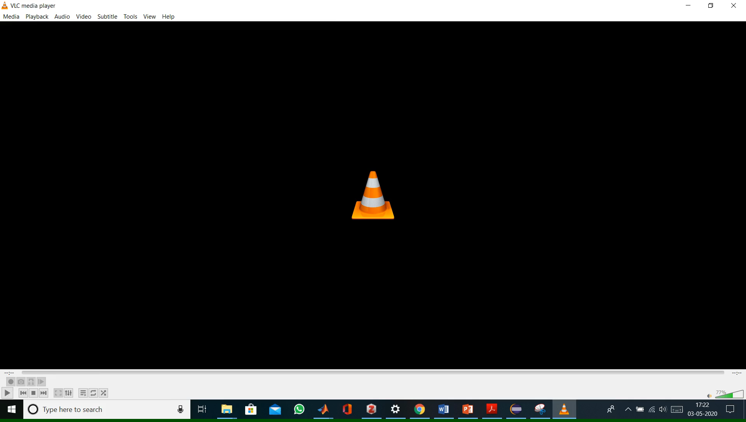
Software Demonstration

Slide 12


